Slide 1



Slide 2
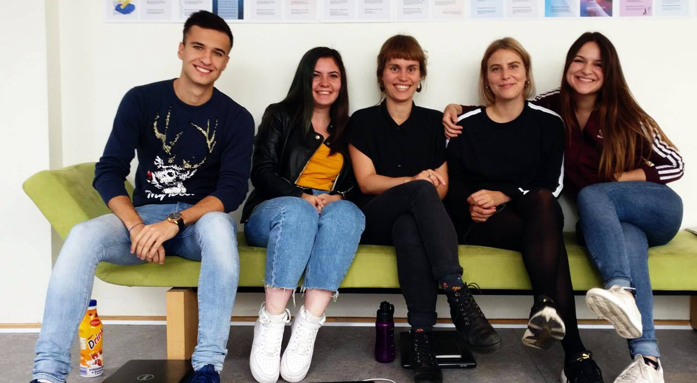
Meet group 12

Slide 3
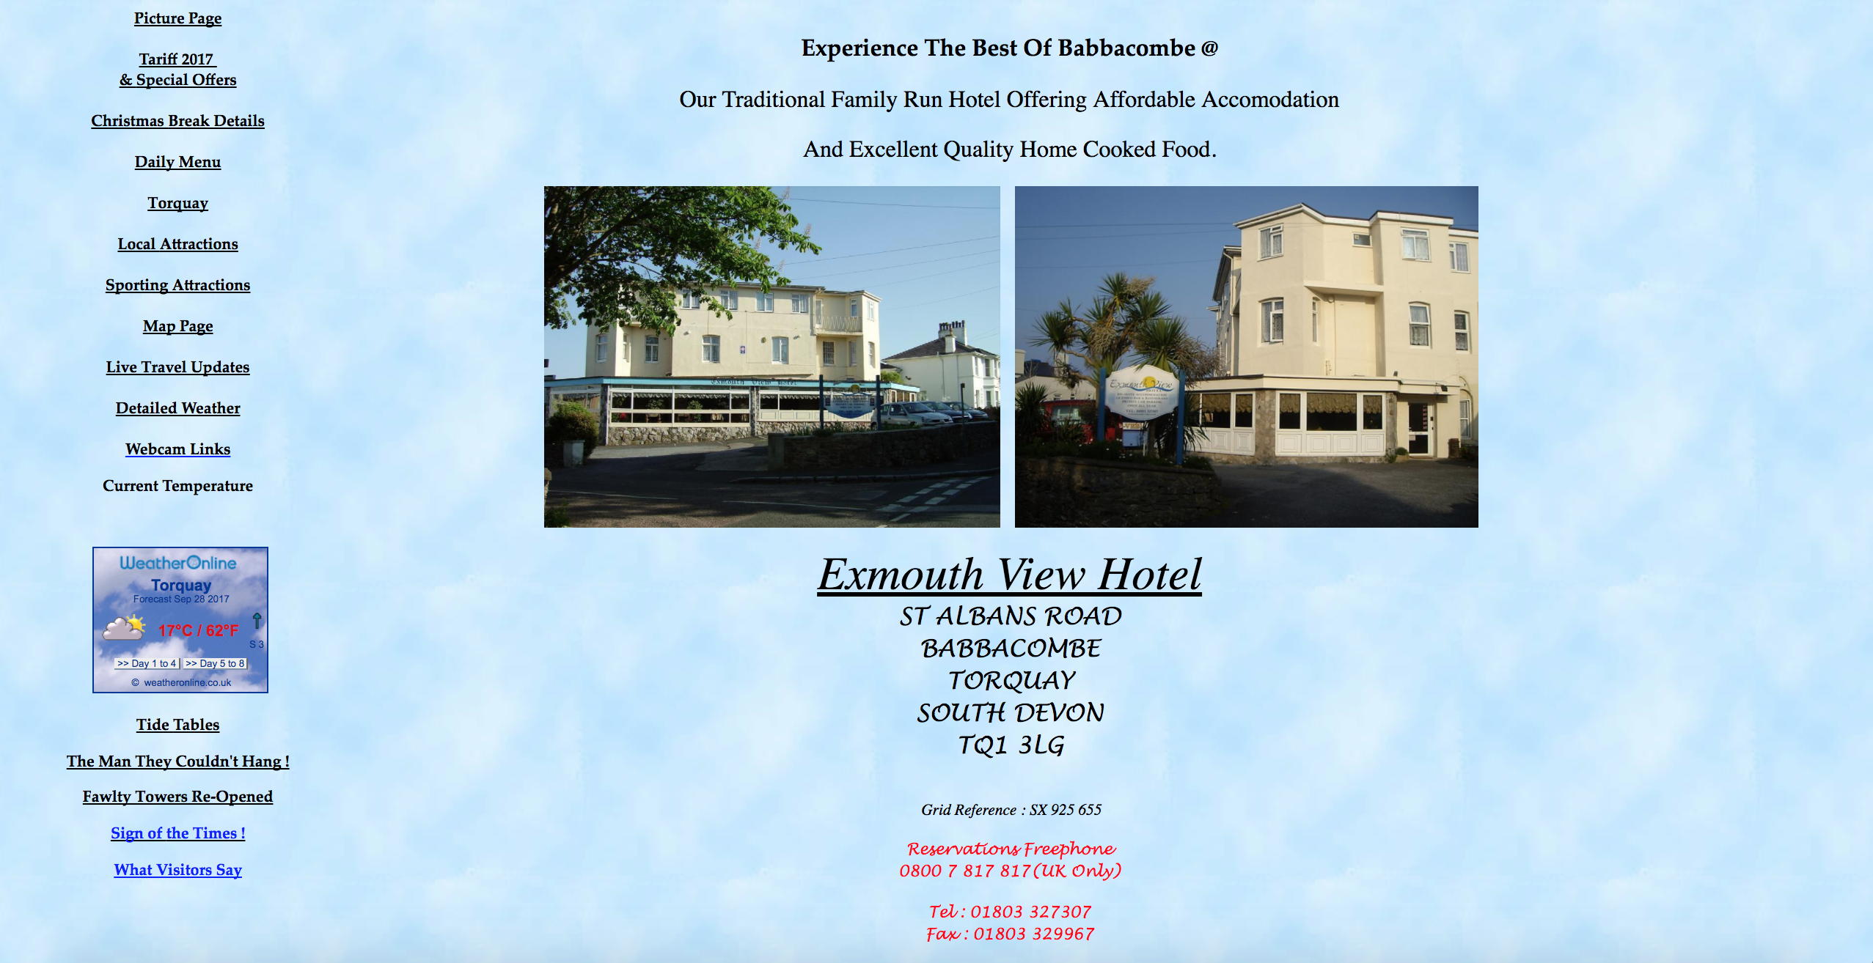
Existing website

Slide 4
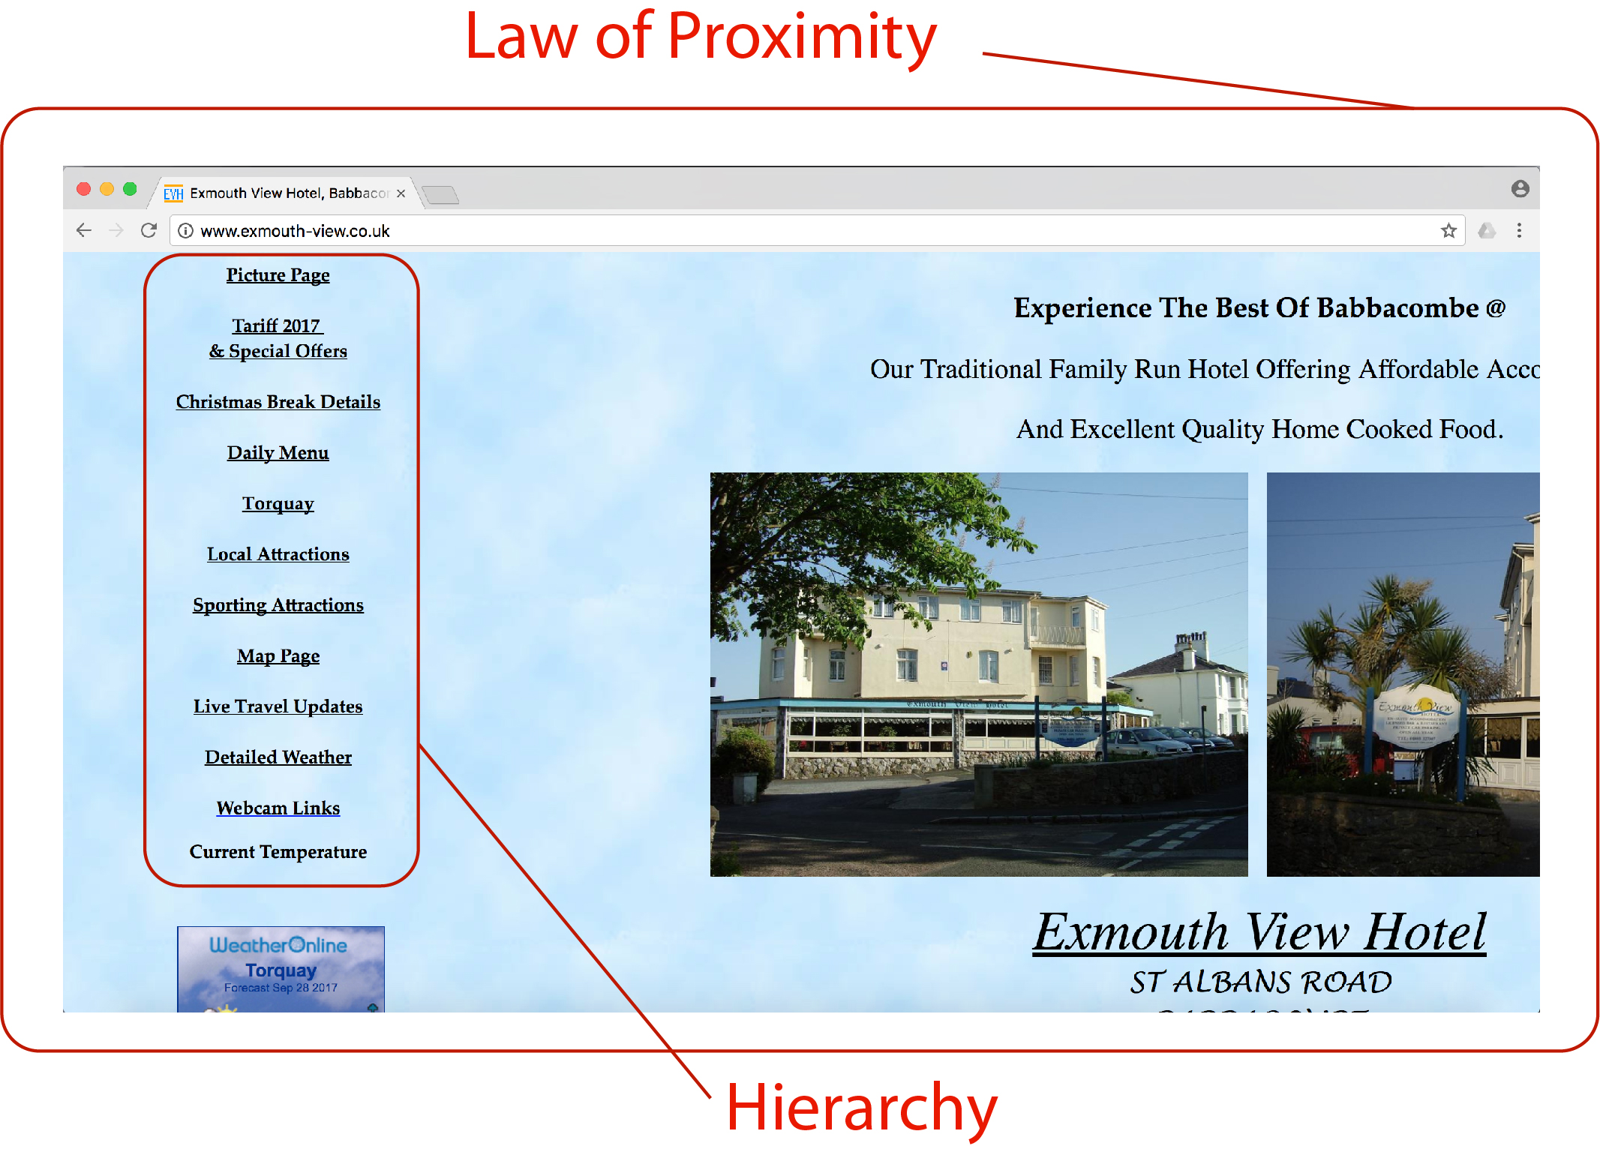
Bad design principles

Slide 5

Moodboard

Slide 6

Logo

Slide 7
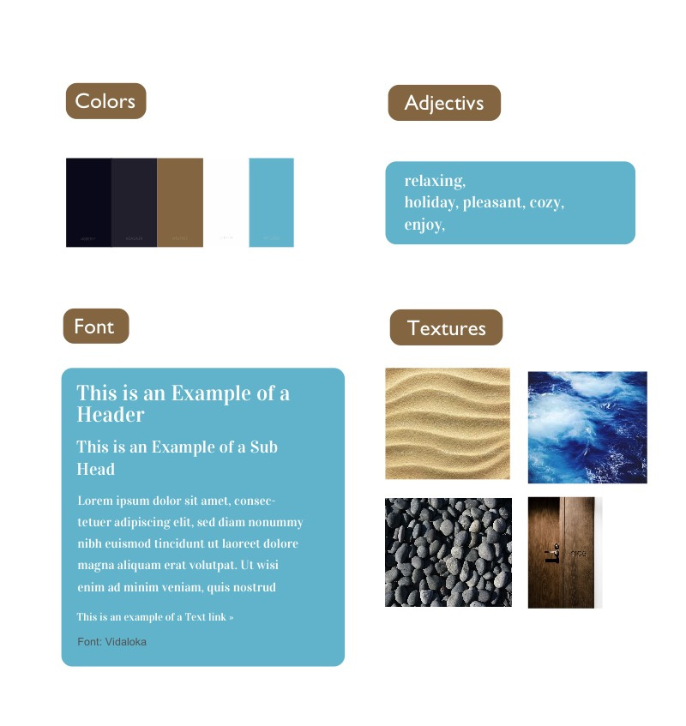
Style tile

Slide 8
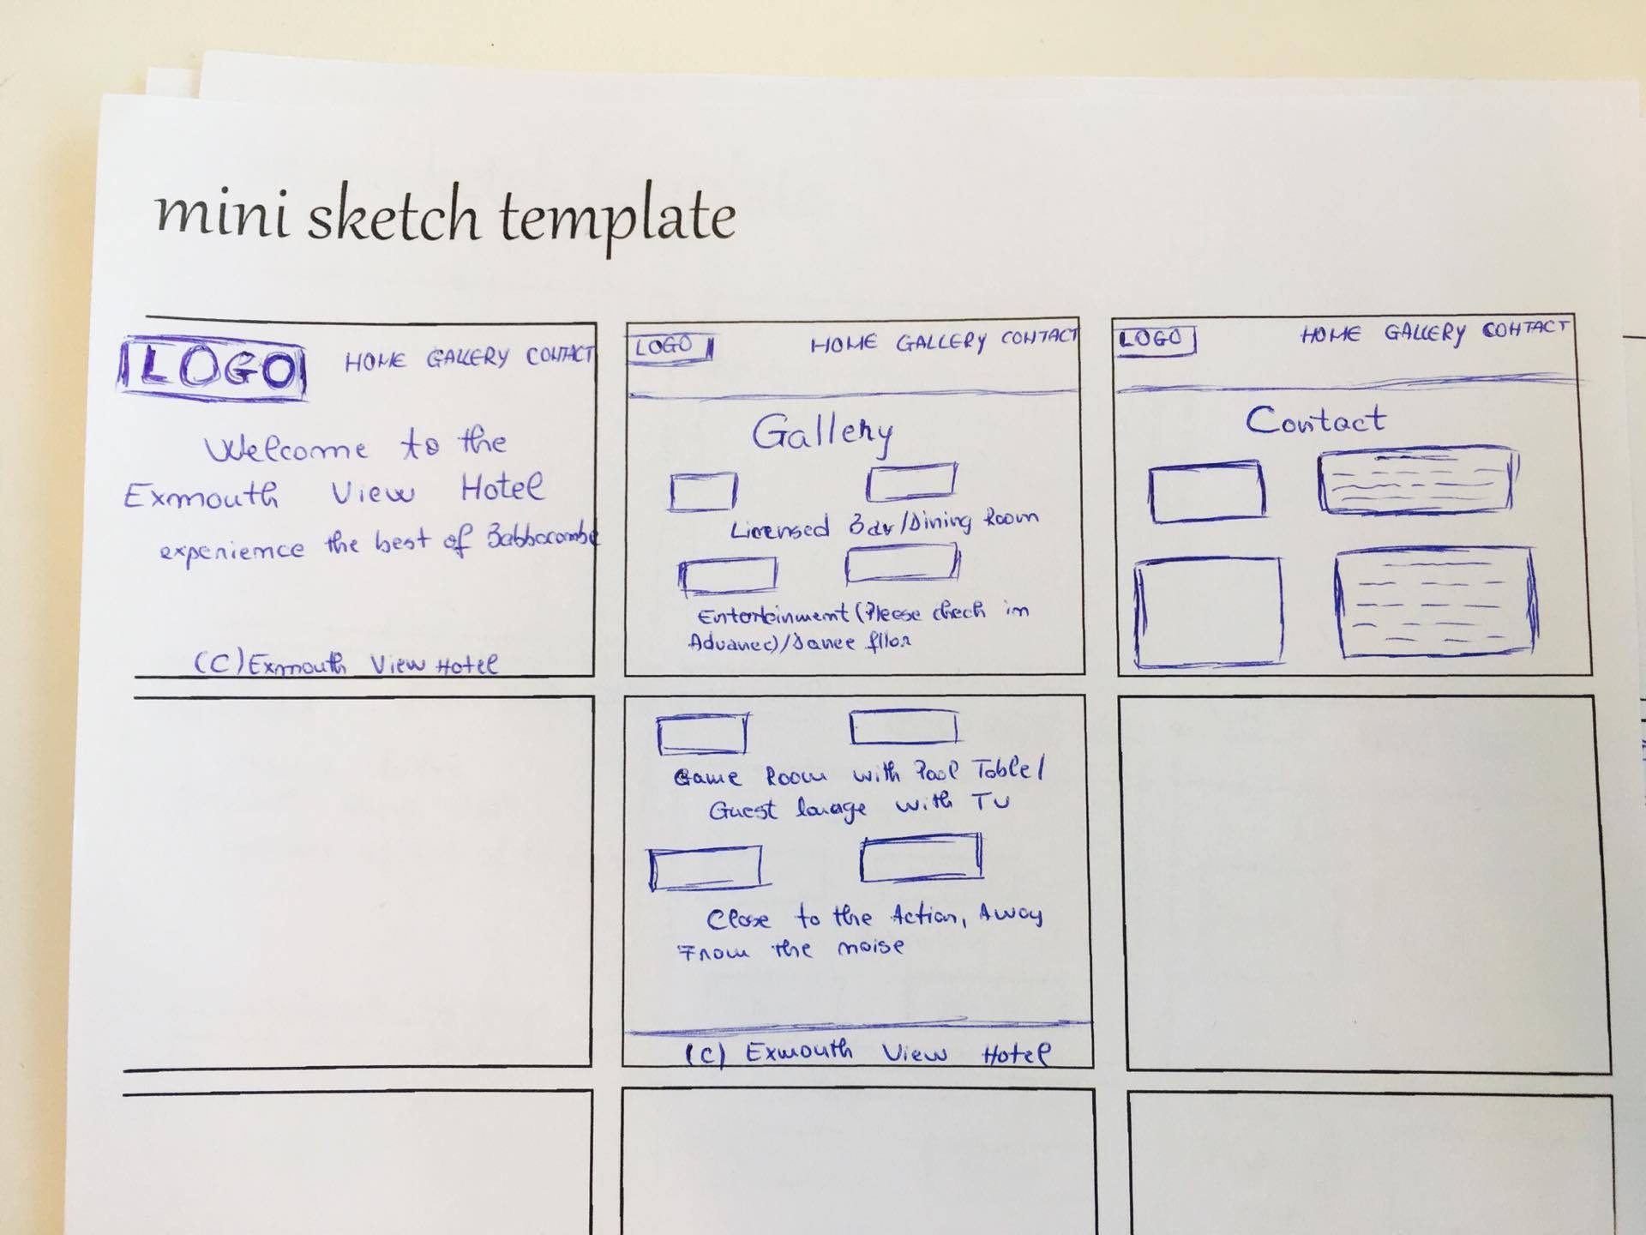
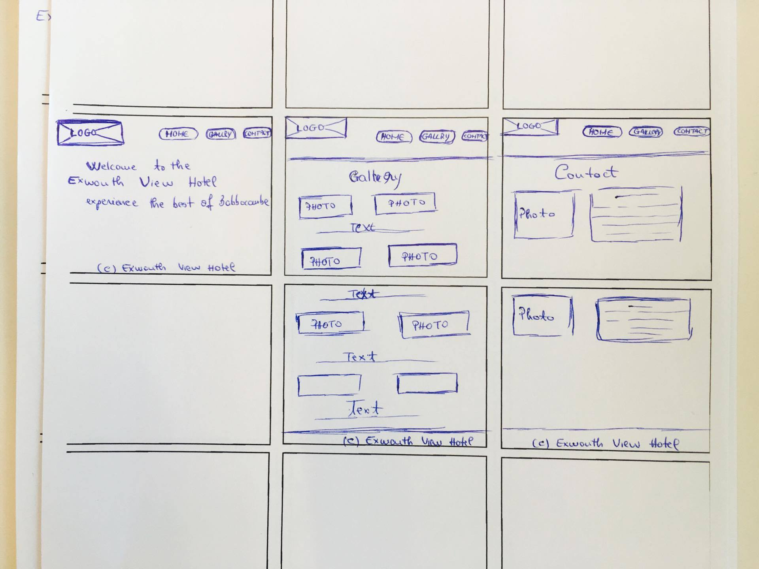
Sketches

Slide 9
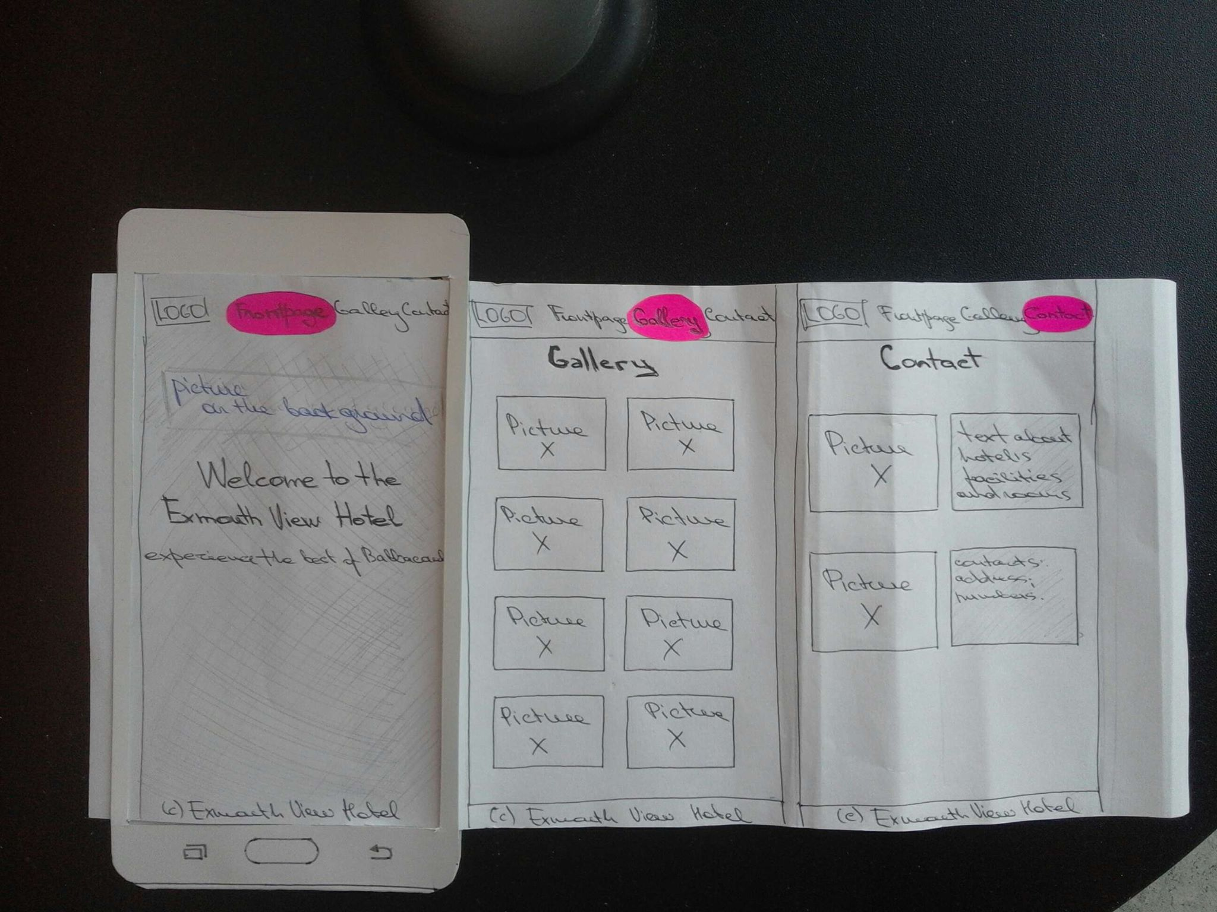
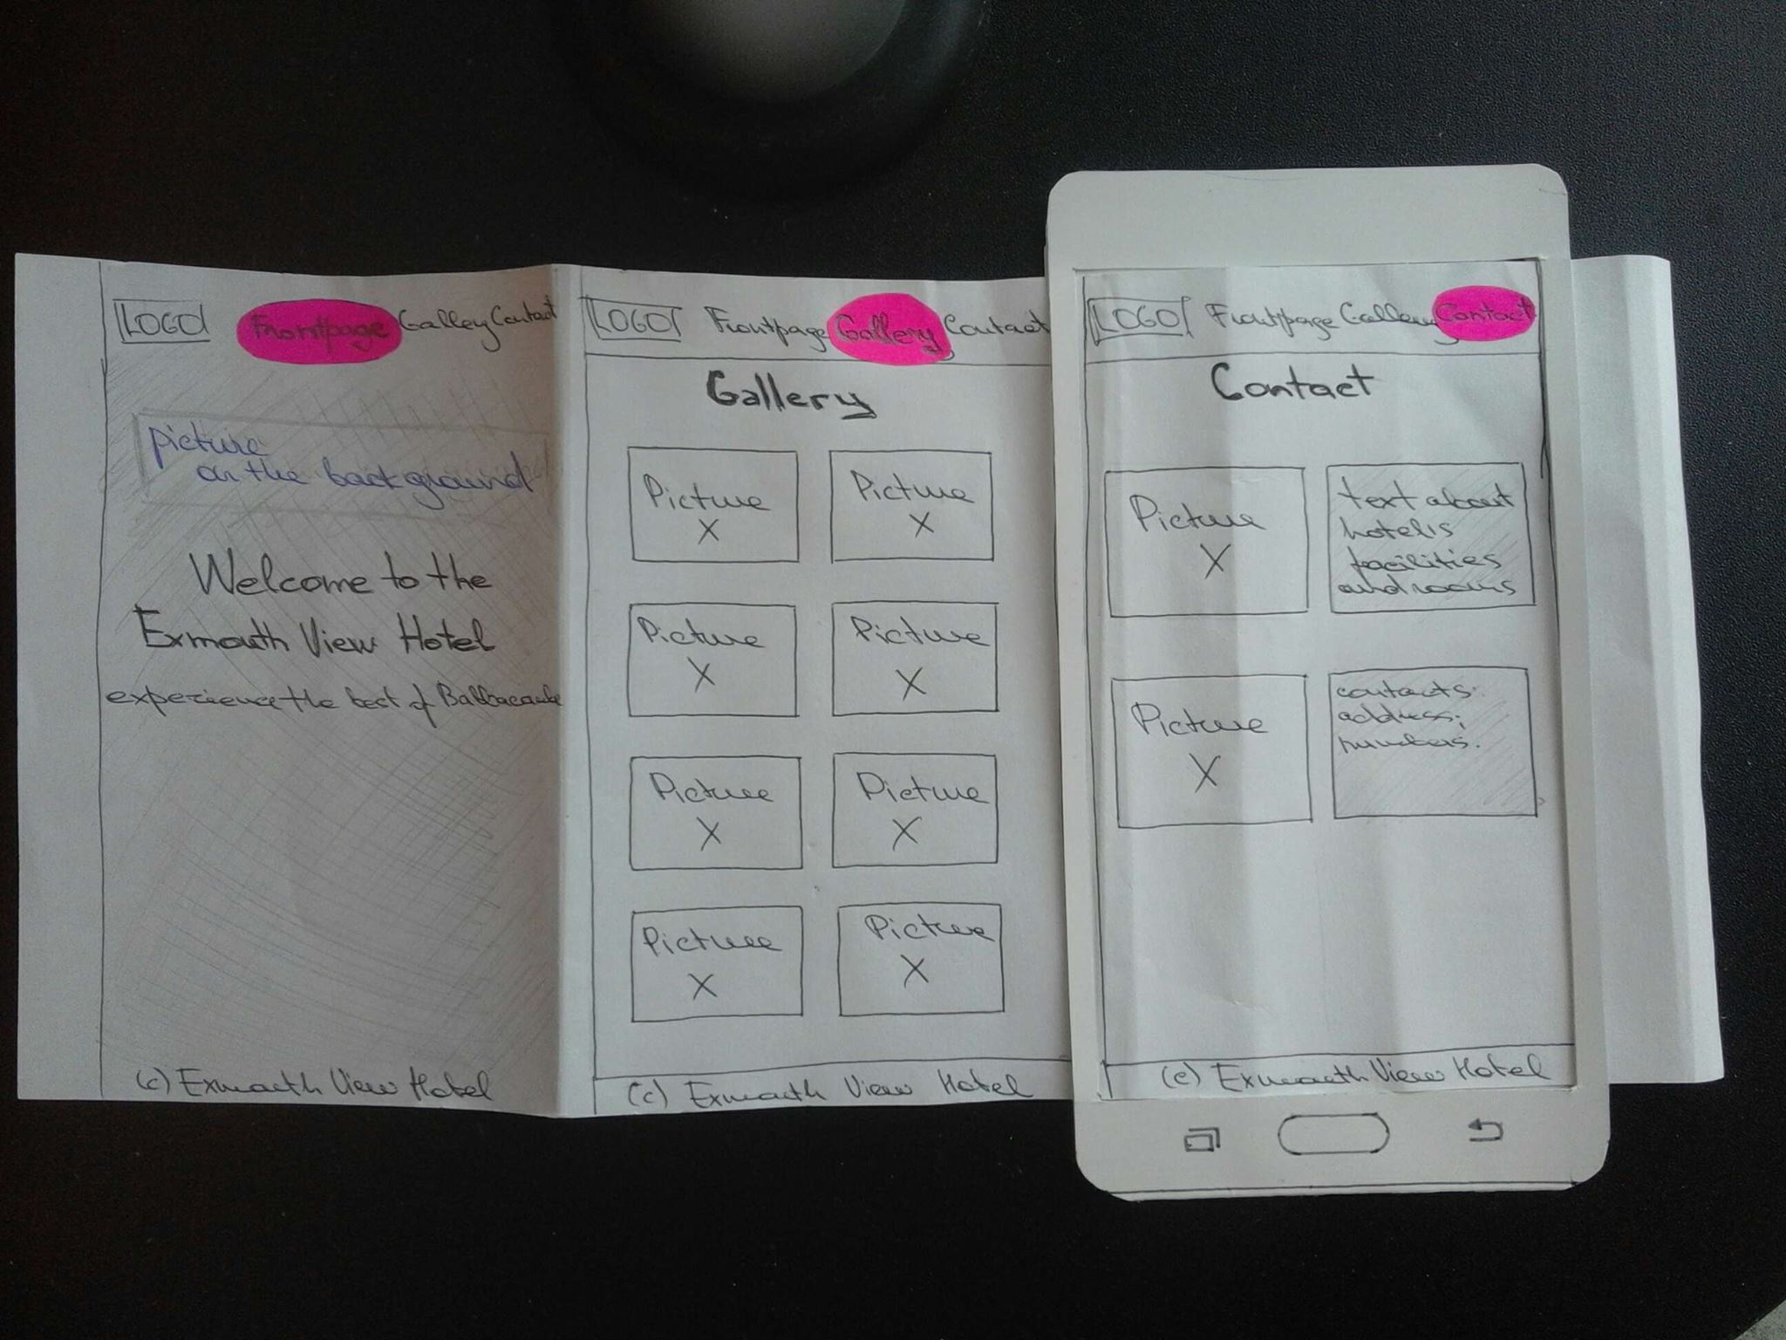
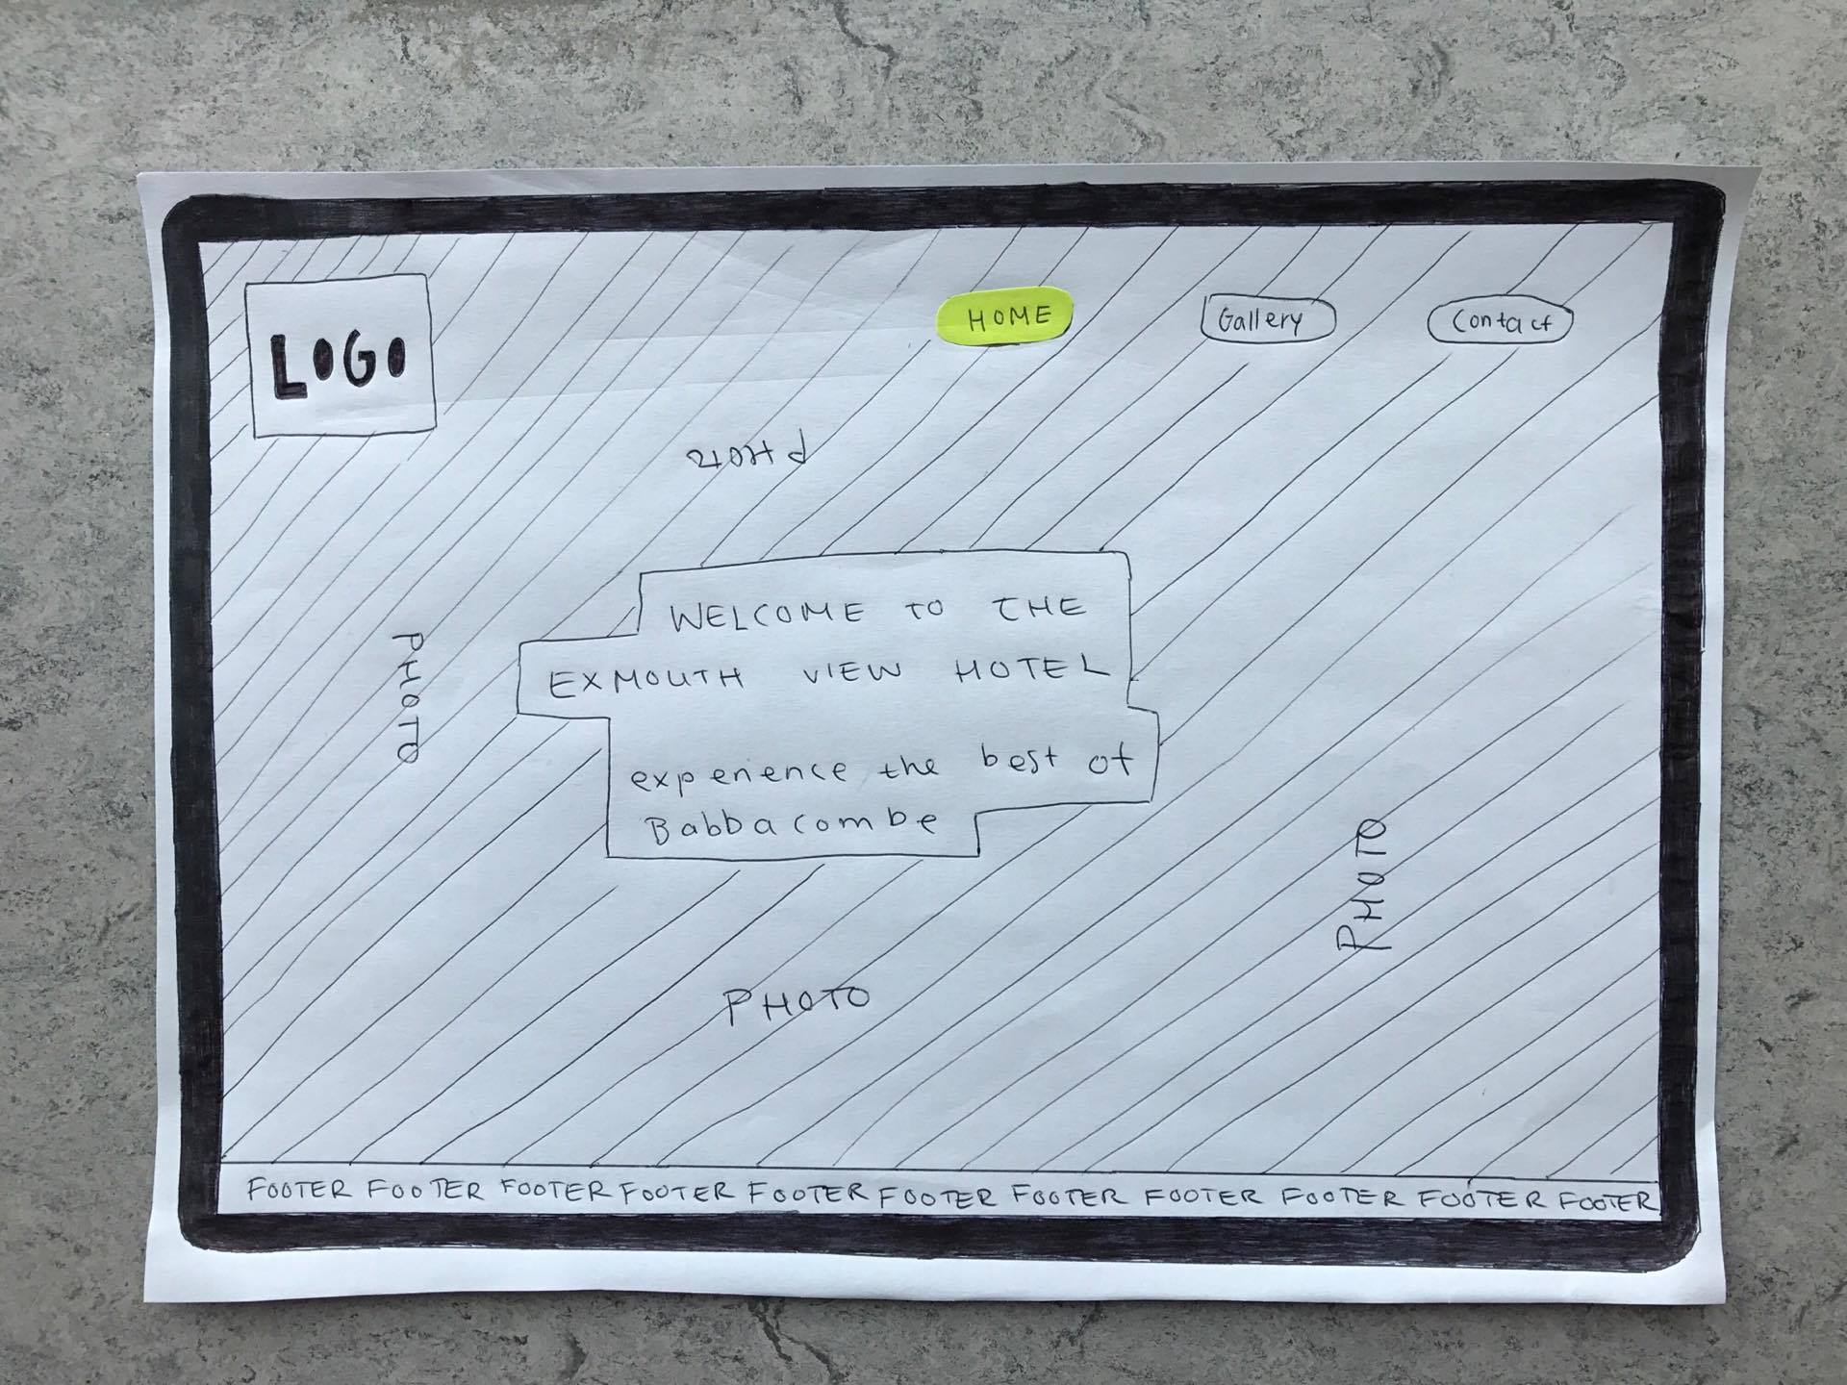
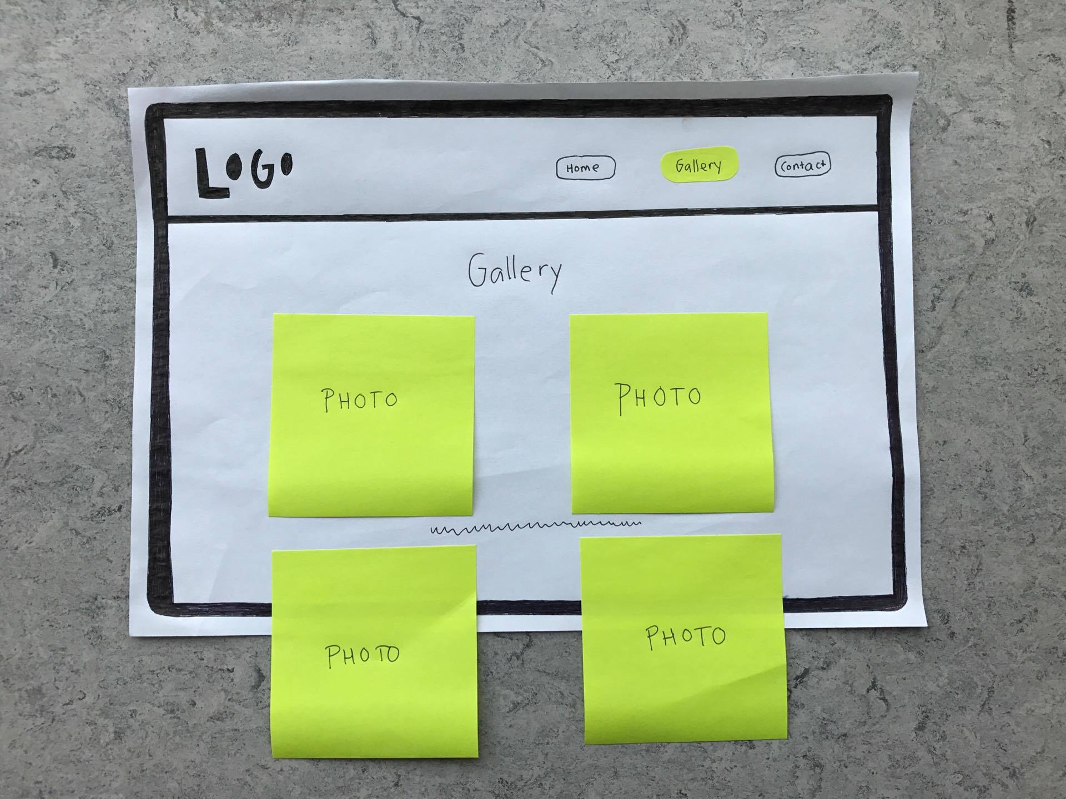
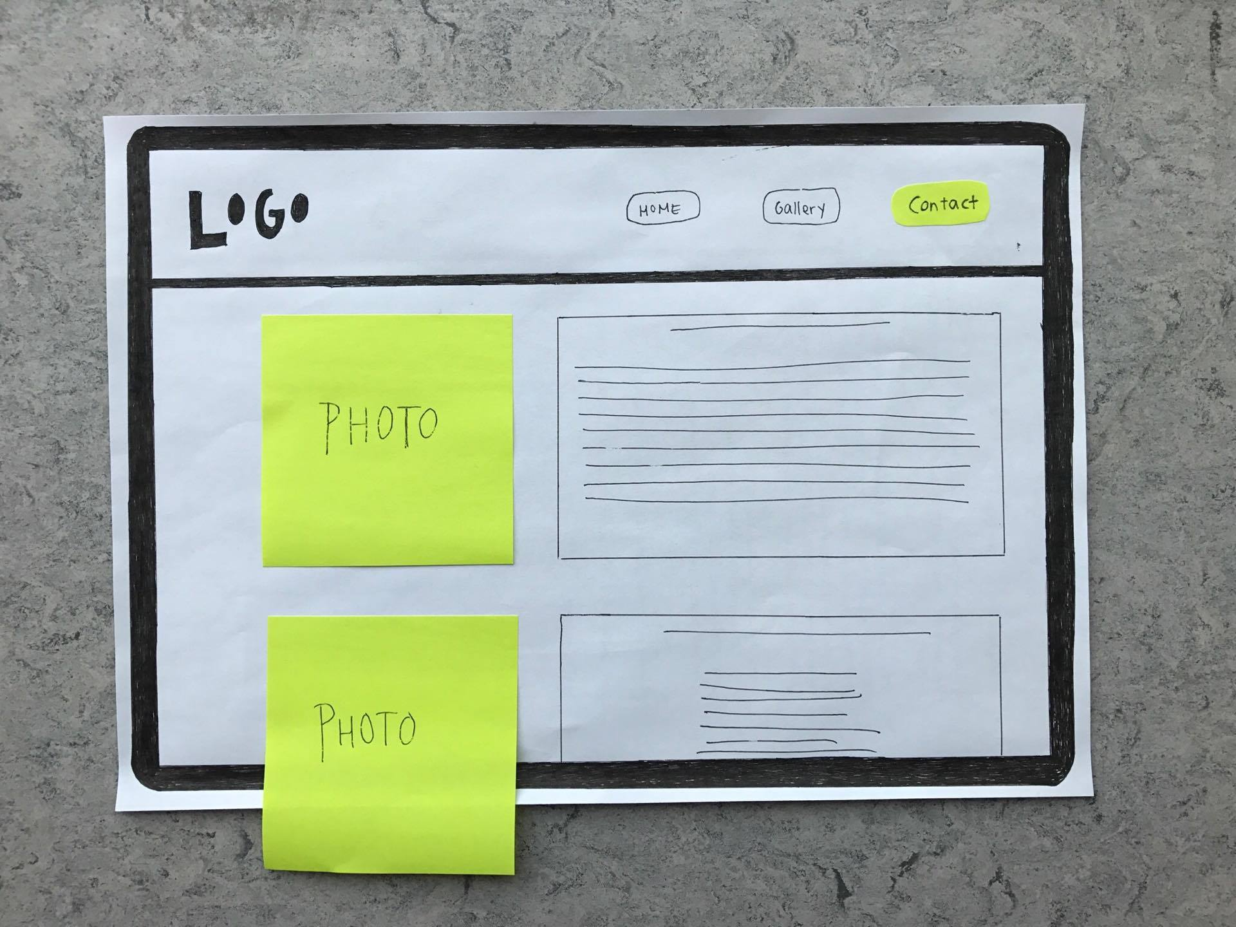
Paper prototypes

Slide 10
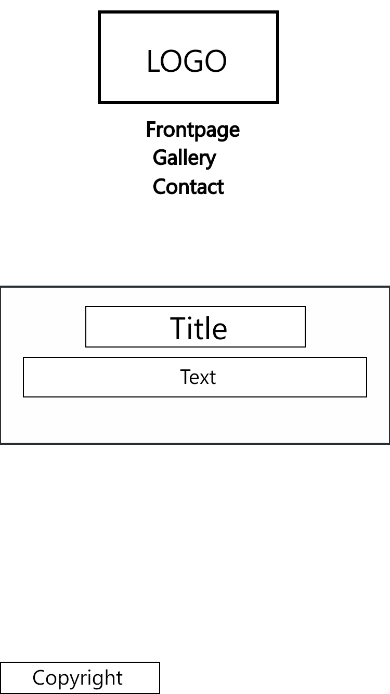
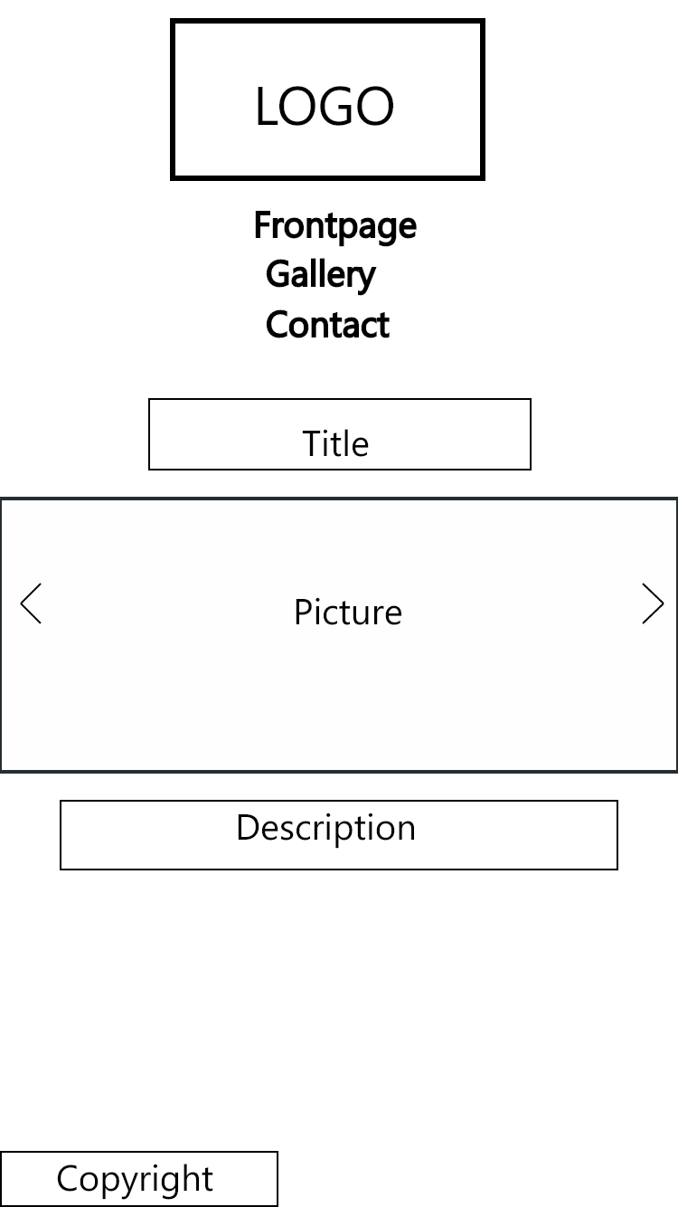
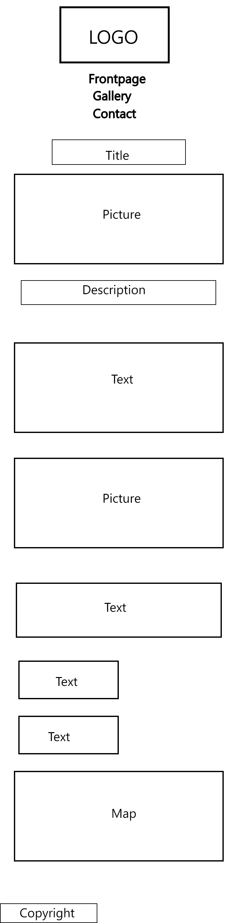
Wireframes

Slide 11

Desktop view

Slide 12

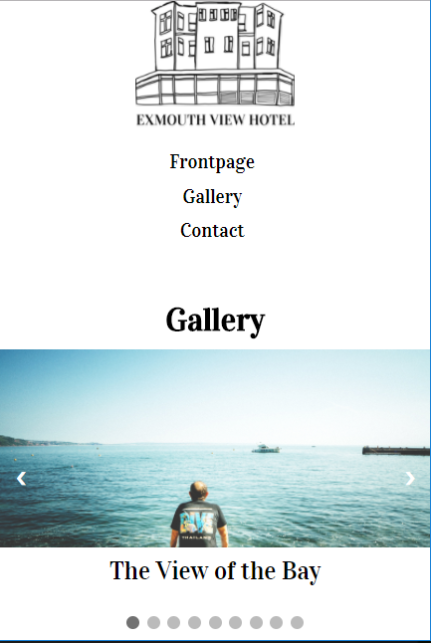

Mobile view

Slide 13
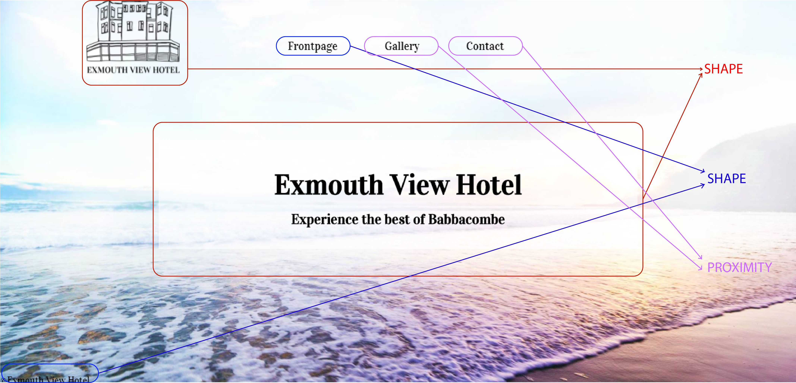
Design principles

Slide 14

LINKS TO XD-PROTOTYPES
(mobile)
https://xd.adobe.com/view/061354b6-bea2-4b70-949b-37a10e4ad575
(desktop)
https://xd.adobe.com/view/5ae500c0-1941-4be9-8ad4-df71626efdaa/

